Slide 1

SDET Course
Design Patterns -Facade

Slide 2
3 Types of Design Patterns
Creational
Singleton
Builder
Prototype
Factory Method
Abstract Factory
Structural
Adapter
Composite
Proxy
Flyweight
Bridge
Facade
Decorator
Behavioral
Strategy
Observer
Command
Memento
State
Template Method
Mediator
Chain of Responsibility
Interpreter
Visitor
Iterator

Slide 3
Agenda
Description
Diagram
Code sample (Java)
Use cases

Slide 4
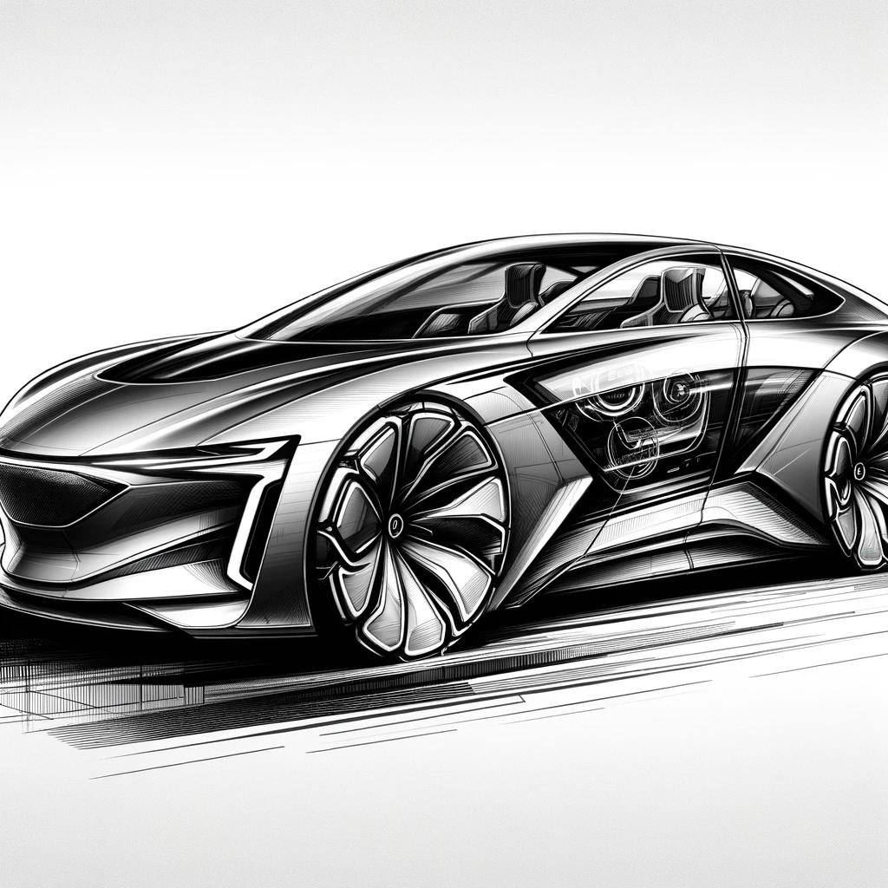
Description
Introduction - Facade

Slide 5
Description
The Facade Design Pattern is a structural design pattern that provides a simplified interface to a complex system of classes, library, or framework. By doing so, it hides the complexities of the system and makes it easier for the client to interact with it. This pattern involves creating a facade class that serves as a single point of access to different parts of a system. The facade class forwards requests from the client to the appropriate components of the system without exposing the underlying details. This reduces dependencies of outside code on the inner workings of the system, leading to better decoupling and easier maintenance. The Facade Pattern is particularly useful when dealing with complex systems with multiple interdependent classes or when there are multiple entry points to a subsystem that needs to be simplified.

Slide 6
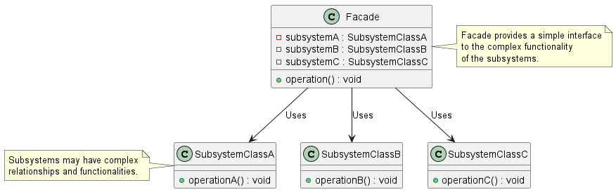
Class Diagram

Slide 7
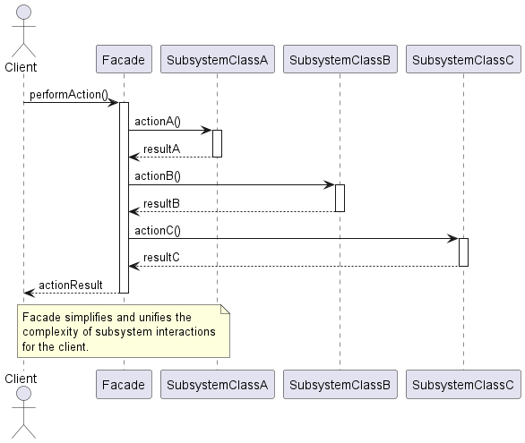
Sequence Diagram

Slide 8
Code Sample

Slide 9
Use cases
General
Wrapping API
Logging interaction (Slf4J)
Legacy Systems
In Test Automation
Search Page Object (Google / Yahoo)
Different resolutions - responsive web sites

Slide 10
Happy Coding

